Slide 1
Heart Disease Prediction
Predicting the likelihood of heart disease using Machine Learning

Slide 2

Introduction

Slide 3
Agenda
Introduction
The Data
Machine Learning
Website

Slide 4
What is Heart Disease?
Heart disease refers to several different types of heart conditions.
The most common type of heart disease in the US is coronary artery disease, which affect the blood flow to the heart and can cause a heart attack.

Slide 5
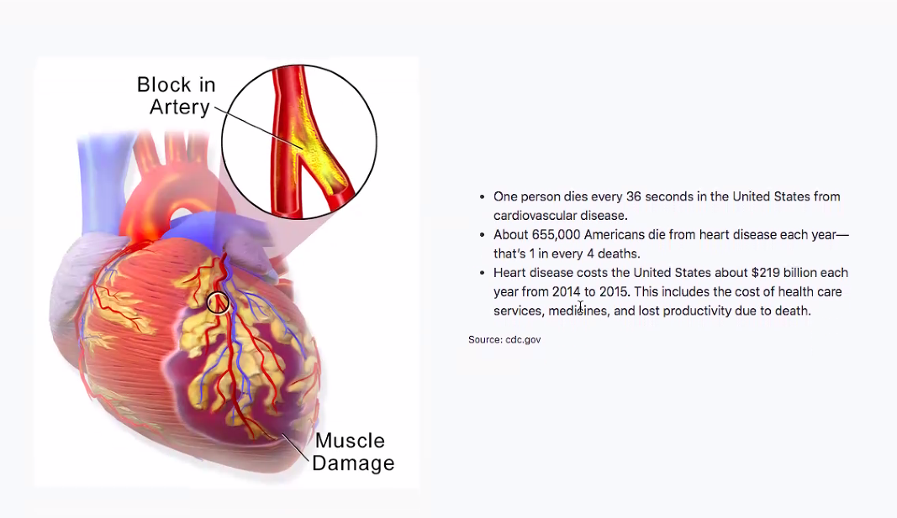
Facts about Heart Disease

Slide 6
The Data

Slide 7



Technologies Used
Train_test_split: To split the dataset into training and testing data
StandardScaler: To scale all the features, so that the ML model better adapts to the dataset
also imported all necessary ML algorithms

Slide 8
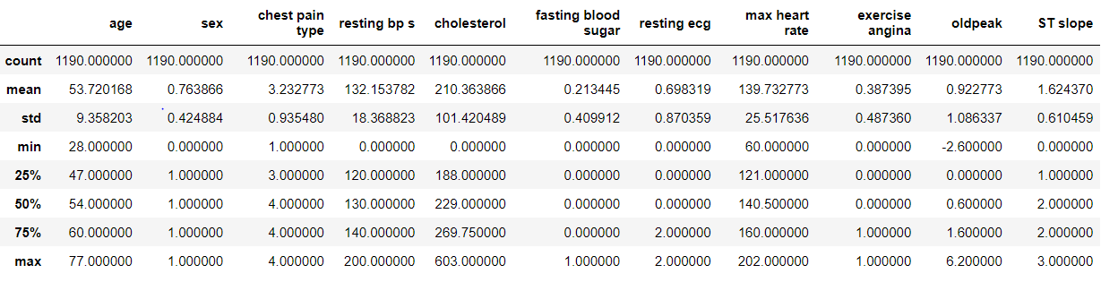
Import dataset
After downloading the data set and reading it in.
There were 11 features and 1 target variable which was dropped
Next, I described the data

Slide 9
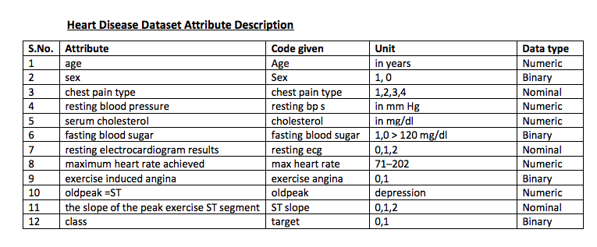
Dataset Documentation

Slide 10
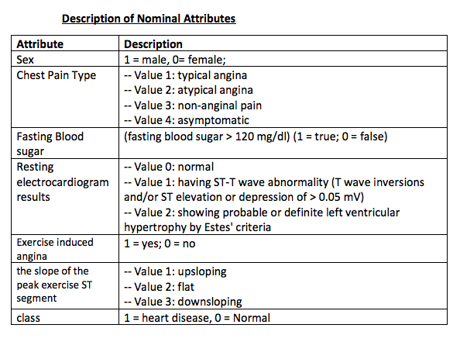
Dataset Documentation

Slide 11
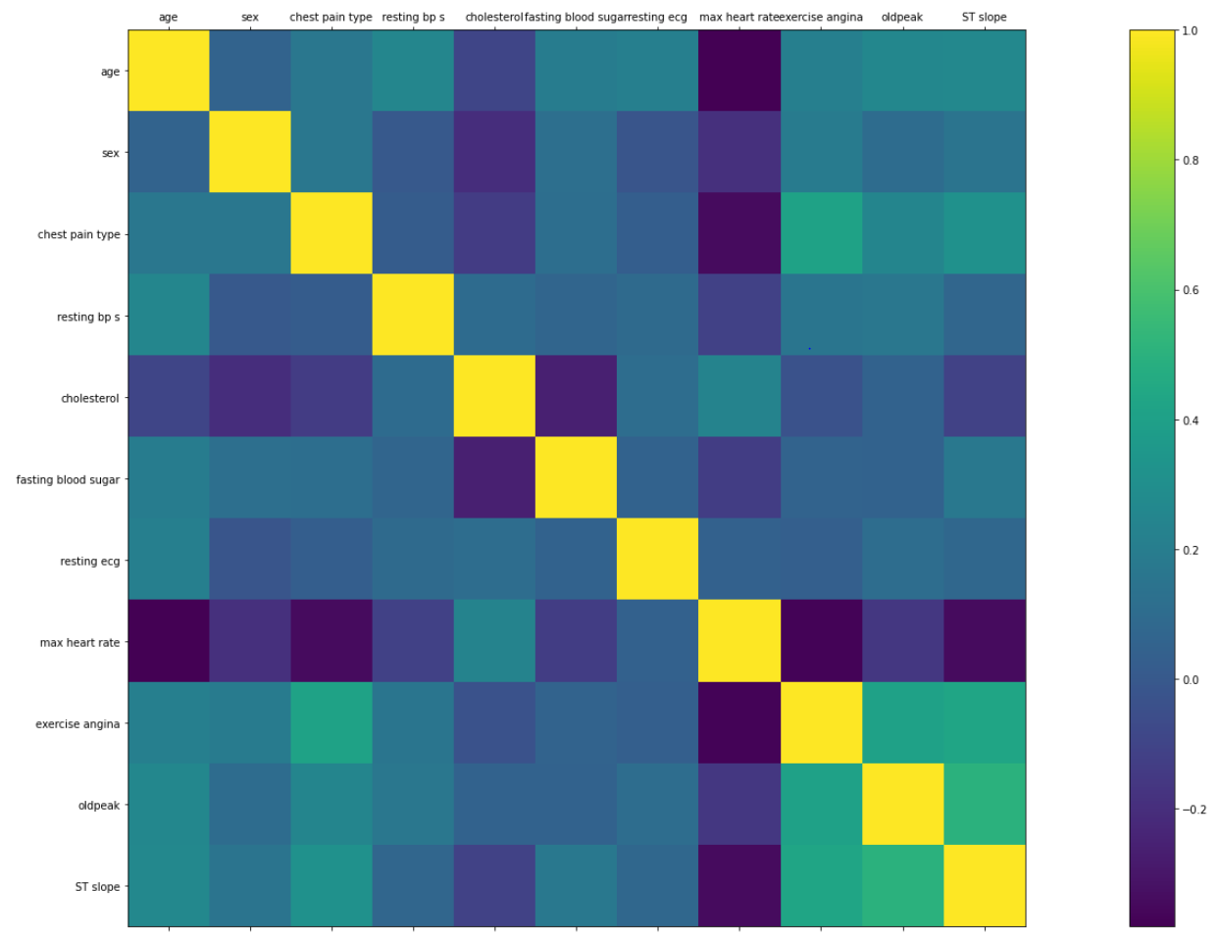
Understanding the data

Slide 12
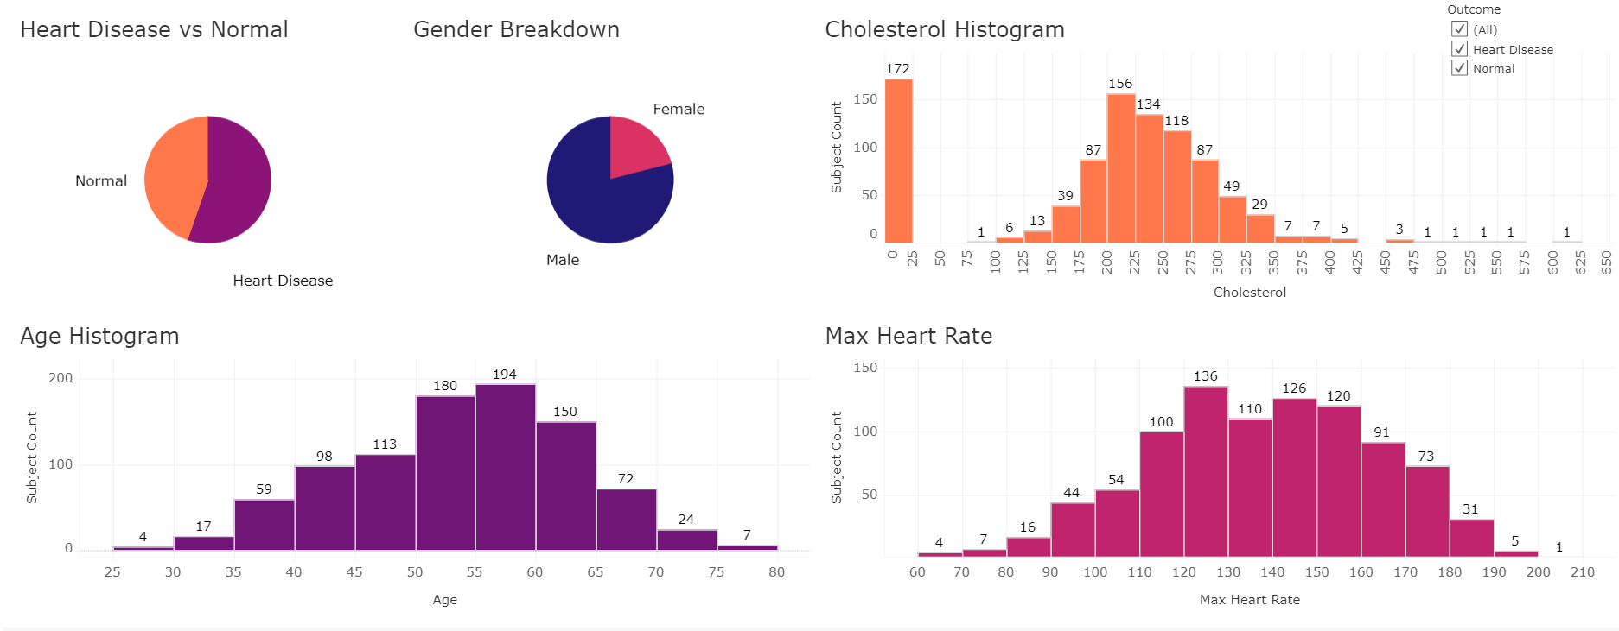
Heart Disease vs. Normal

Slide 13
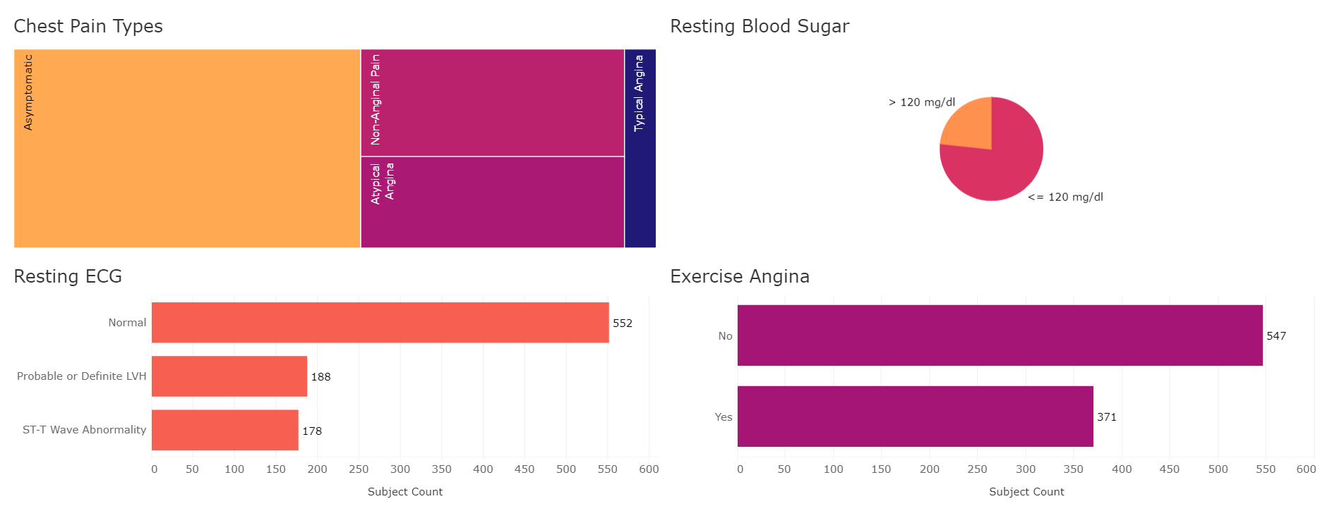
Heart Disease vs. Normal

Slide 14
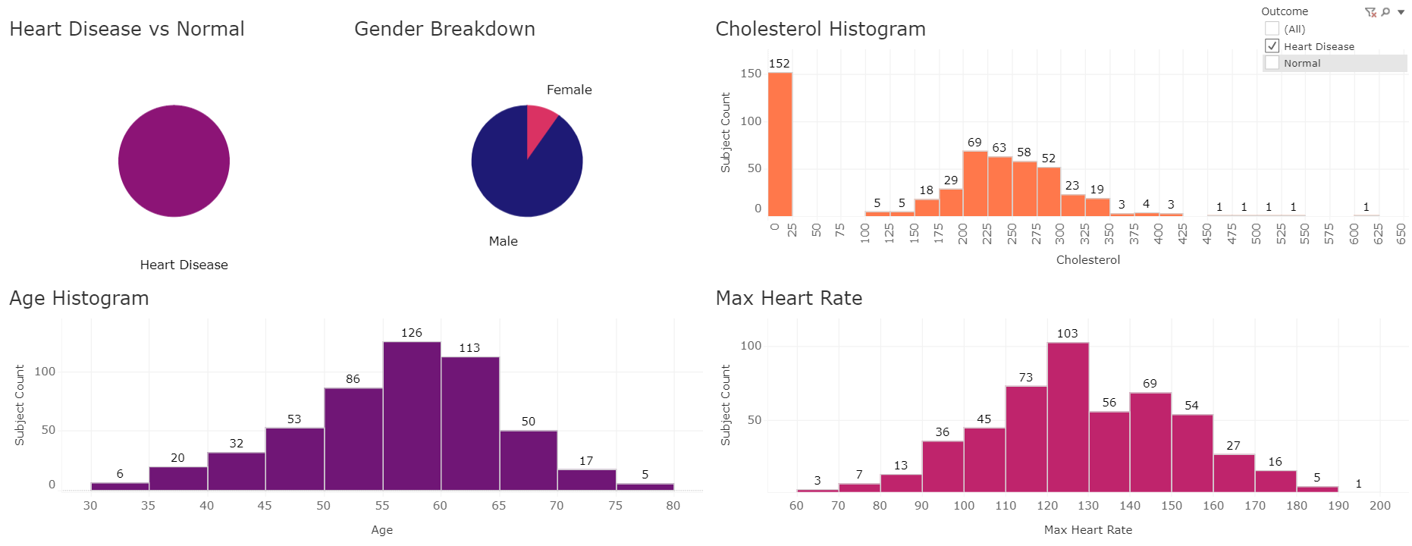
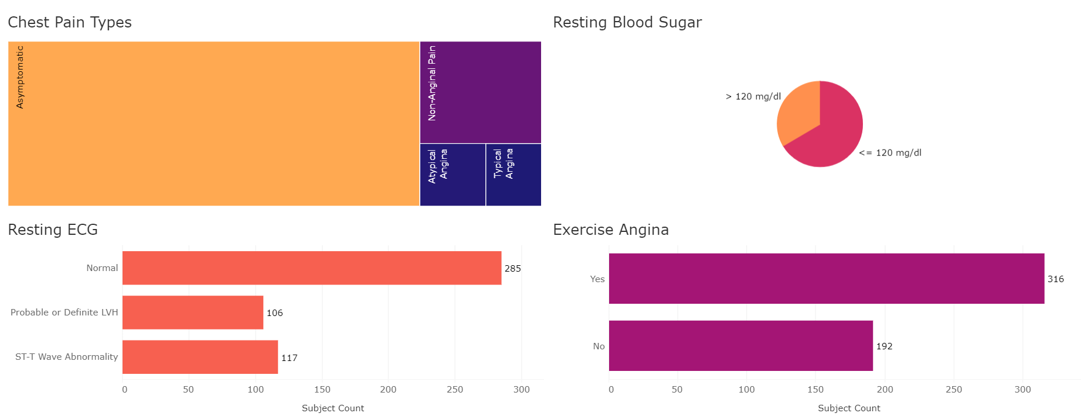
Filtered: Heart Disease

Slide 15
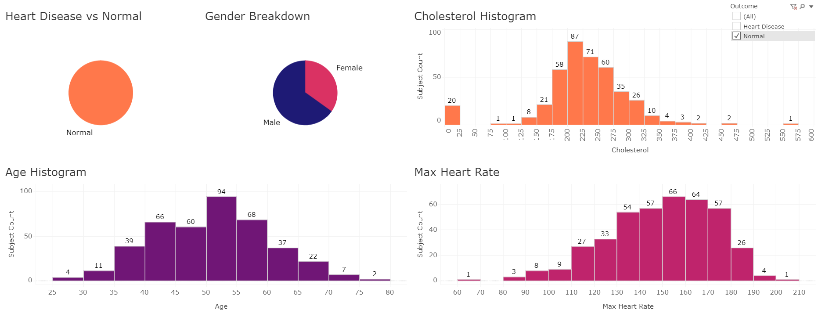
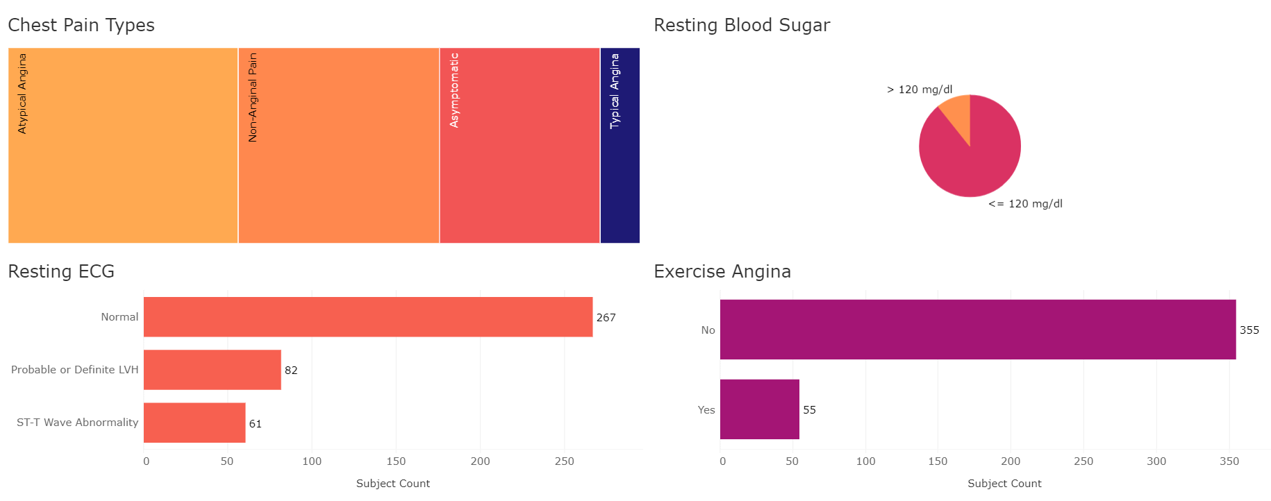
Filtered: Normal

Slide 16
Machine Learning

Slide 17
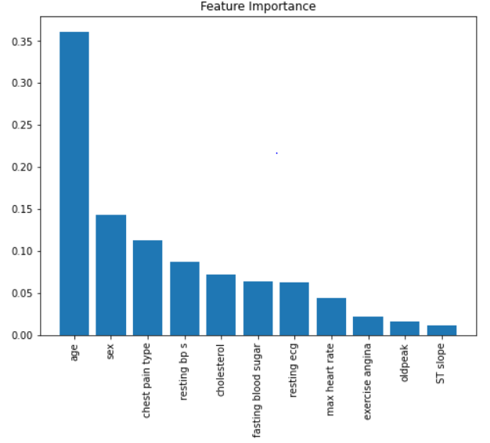
Feature Selection

Slide 18
Support Vector Classifier
This classifier aims at forming a hyperplane that can separate the classes as much as possible by adjusting the distance between the data points and the hyperplane.
We used the four kernels to decide the hyperplane: linear, poly, rbf, and sigmoid

Slide 19
Benefits of SVCs
SVCs can work with multiple classes
SVCs work well when there is a clear margin of separation between classes
SVM is effective in cases where the number of dimensions is greater than the number of samples

Slide 20
Challenges using SVM
This algorithm is not suitable for large data sets
SVM does not perform very well when the data has target classes that are overlapping
SVMs will not be able to perfectly separate classes.

Slide 21
Mortality Rate Data from CDC
In order to give our model a bit more context, and to test if our conclusions were correct, we pulled and visualized in Tableau heart disease mortality rate data from the CDC.
Notes:
Pivot to show in website

Slide 22
Website

Slide 23
Questions?

